Slide 1
Chapter 8
Normalization
Transparencies
© Pearson Education Limited, 2004

Slide 2
Chapter 8 - Objectives
How tables that contain redundant data can suffer from update anomalies, which can introduce inconsistencies into a database.
The rules associated with the most commonly used normal forms, namely first (1NF), second (2NF), and third (3NF).
The identification of various types of update anomalies such as insertion, deletion, and modification anomalies.
© Pearson Education Limited, 2004

Slide 3
Chapter 8 - Objectives
How tables that break the rules of 1NF, 2NF, and 3NF are likely to contain redundant data and suffer from update anomalies.
How to restructure tables that break the rules of 1NF, 2NF, and 3NF.
© Pearson Education Limited, 2004

Slide 4
Normalization
A technique for producing a set of tables with desirable properties that support the requirements of a user or company.
© Pearson Education Limited, 2004

Slide 5
Data redundancy and update anomalies
Major aim of relational database design is to group columns into tables to minimize data redundancy and reduce file storage space required by base tables.
Problems associated with data redundancy are illustrated by comparing the Staff and Branch tables with the StaffBranch table.
© Pearson Education Limited, 2004

Slide 6
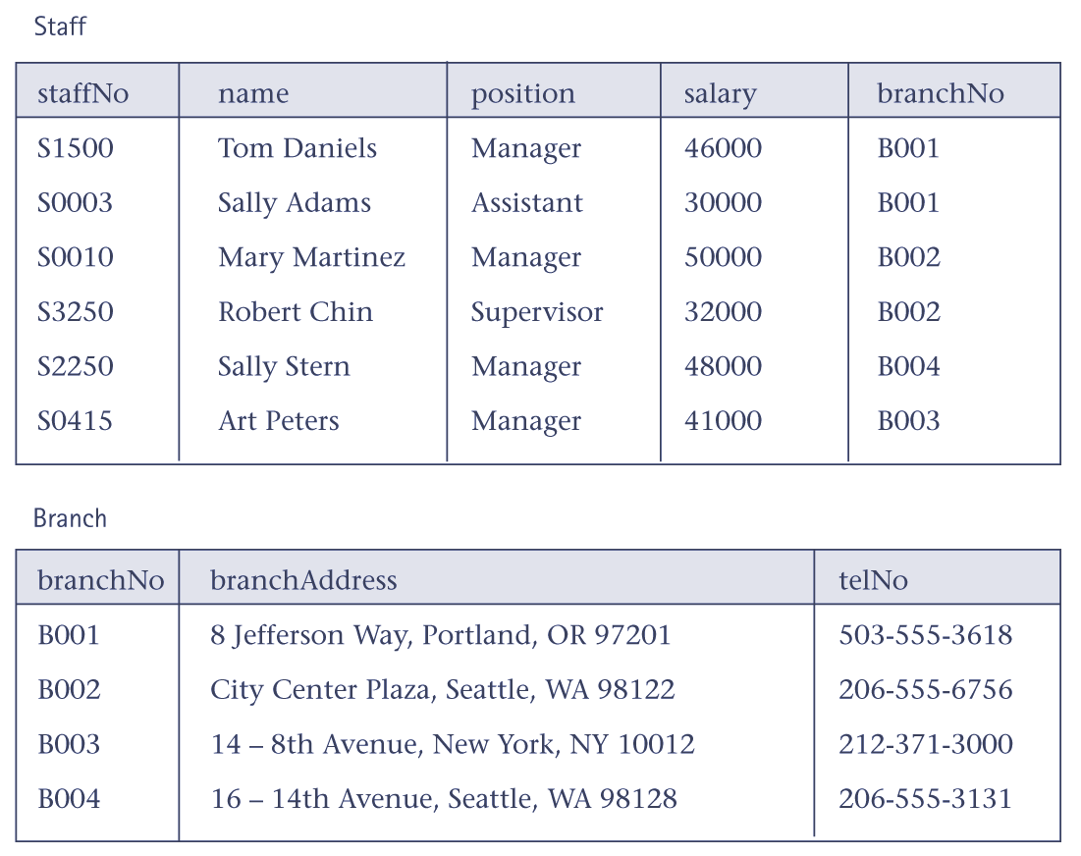
Data redundancy and update anomalies
© Pearson Education Limited, 2004

Slide 7
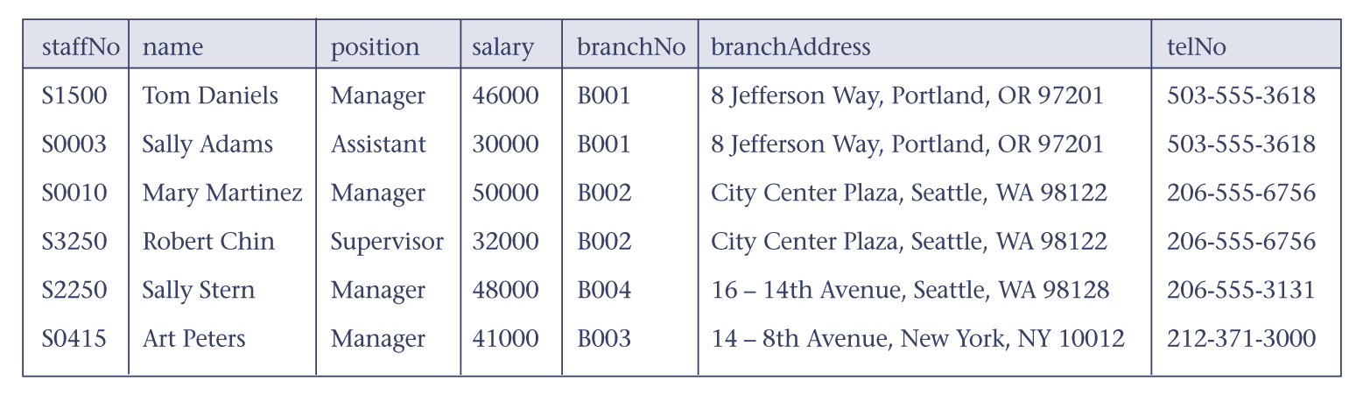
Data redundancy and update anomalies
© Pearson Education Limited, 2004

Slide 8
Data redundancy and update anomalies
StaffBranch table has redundant data; the details of a branch are repeated for every member of staff.
In contrast, the branch information appears only once for each branch in the Branch table and only the branch number (branchNo) is repeated in the Staff table, to represent where each member of staff is located.
© Pearson Education Limited, 2004

Slide 9
Data redundancy and update anomalies
Tables that contain redundant information may potentially suffer from update anomalies.
Types of update anomalies include
  insertion
  deletion
  modification
© Pearson Education Limited, 2004

Slide 10
First normal form (1NF)
Only 1NF is critical in creating appropriate tables for relational databases. All subsequent normal forms are optional.
A table in which the intersection of every column and record contains only one value.
© Pearson Education Limited, 2004

Slide 11
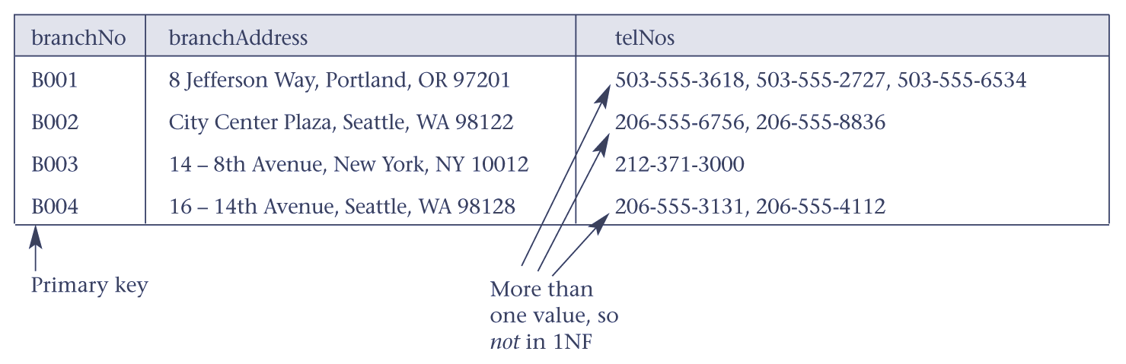
Branch table is not in 1NF
© Pearson Education Limited, 2004

Slide 12
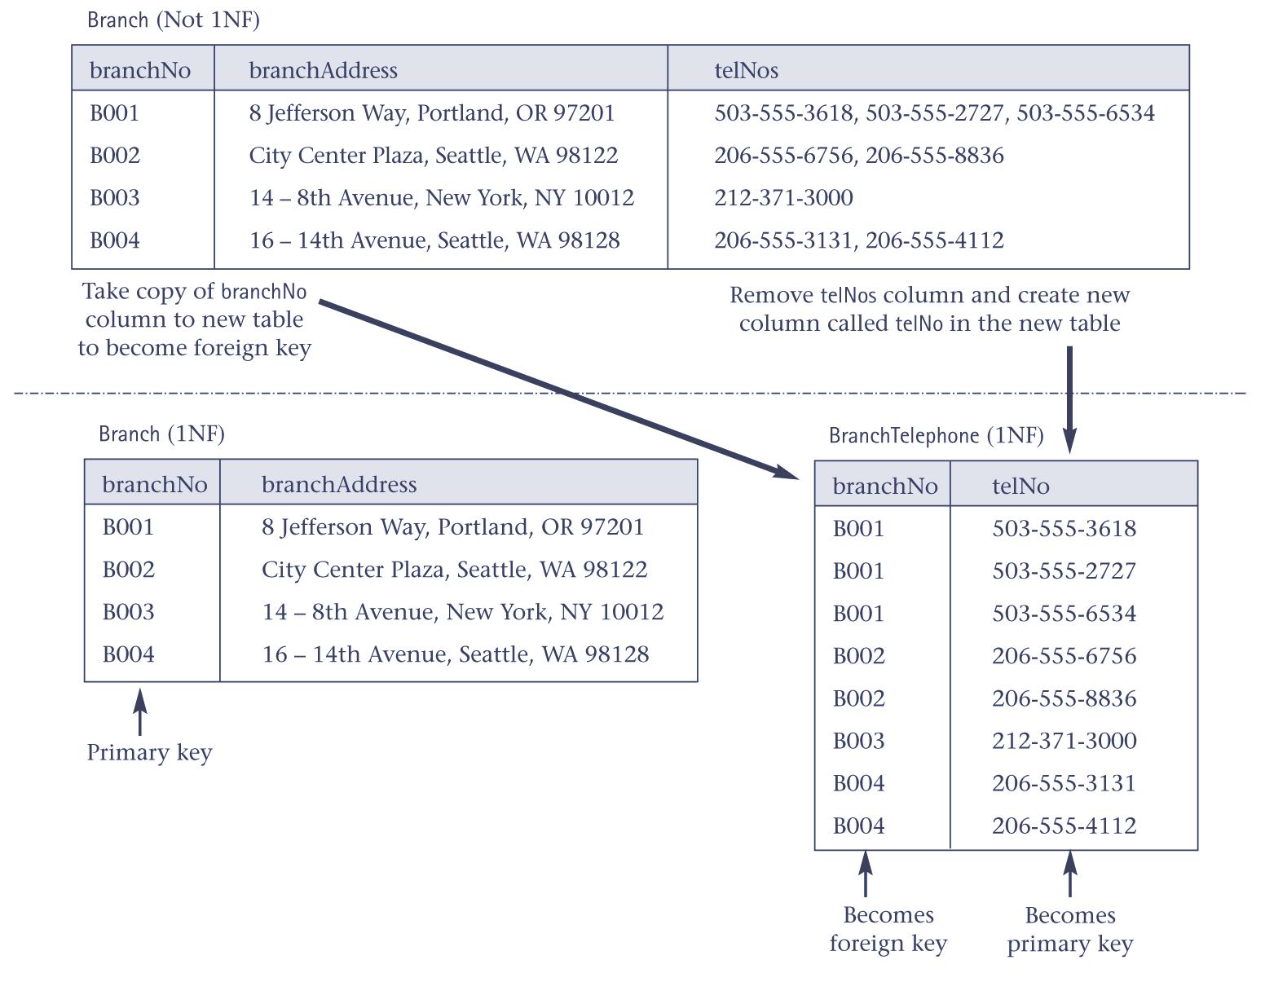
Converting Branch table to 1NF
© Pearson Education Limited, 2004

Slide 13
Second normal form (2NF)
2NF only applies to tables with composite primary keys.
A table that is in 1NF and in which the values of each non-primary-key column can be worked out from the values in all the columns that make up the primary key.
© Pearson Education Limited, 2004

Slide 14
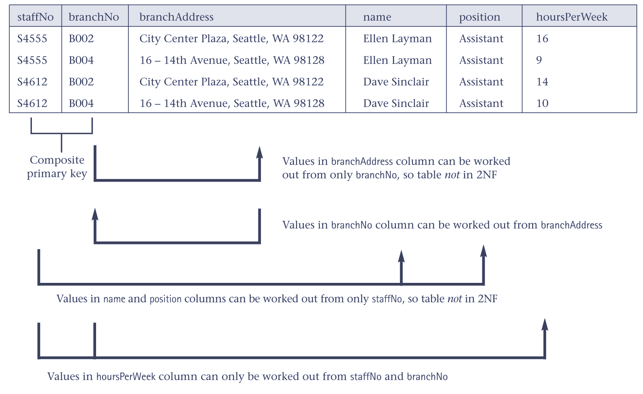
TempStaffAllocation table is not in 2NF
© Pearson Education Limited, 2004

Slide 15
Functional dependency
The particular relationships that we show between the columns of a table are more formally referred to as functional dependencies.
Functional dependency describes the relationship between columns in a table.
© Pearson Education Limited, 2004

Slide 16
Functional dependency
For example, consider a table with columns A and B, where B is functionally dependent on A (denoted A → B). If we know the value of A, we find only one value of B in all the records that has this value of A, at any moment in time.
© Pearson Education Limited, 2004

Slide 17
Second normal form (2NF)
Formal definition of 2NF is a table that is in 1NF and every non-primary-key column is fully functional dependent on the primary key.
Full functional dependency indicates that if A and B are columns of a table, B is fully dependent on A if B is functionally dependent on A but not on any proper subset of A.
© Pearson Education Limited, 2004

Slide 18
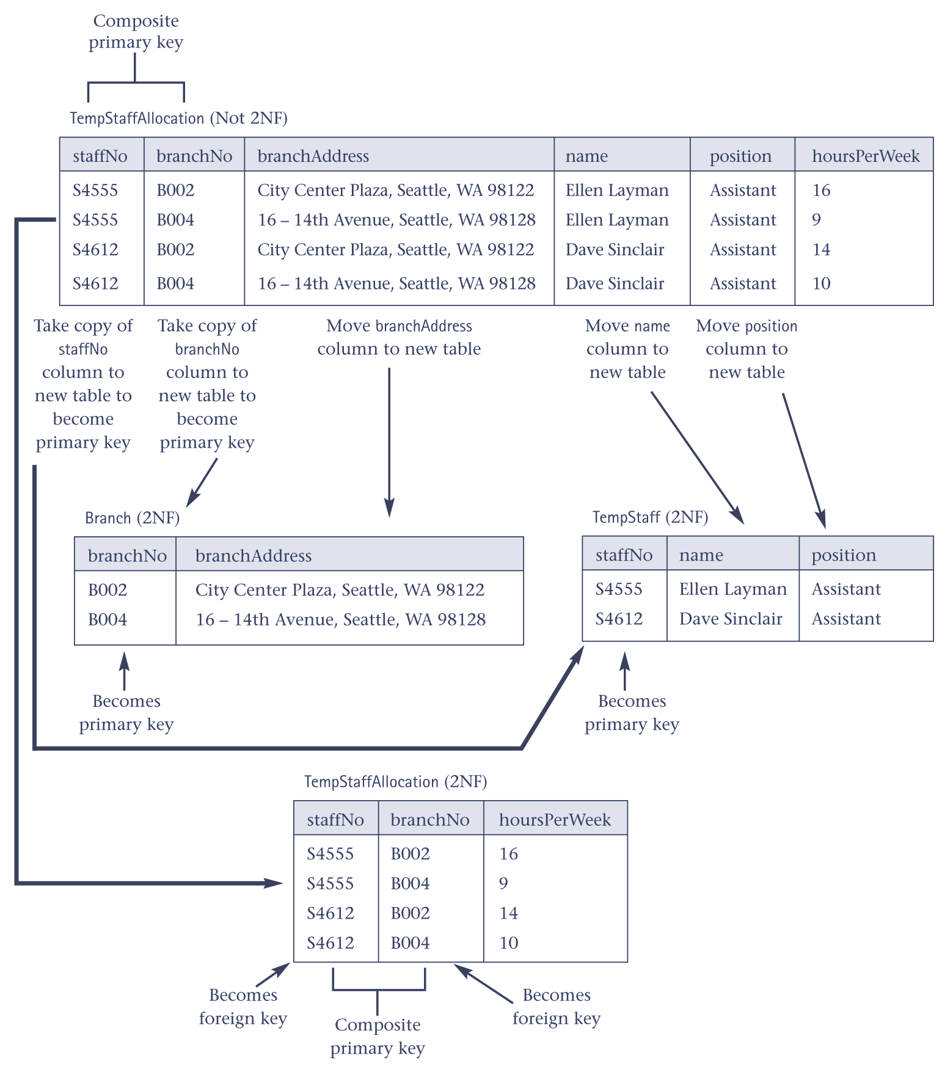
Converting TempStaffAllocation table to 2NF
© Pearson Education Limited, 2004

Slide 19
Third normal form (3NF)
A table that is in 1NF and 2NF and in which all non-primary-key column can be worked out from only the primary key column(s) and no other columns.
© Pearson Education Limited, 2004

Slide 20
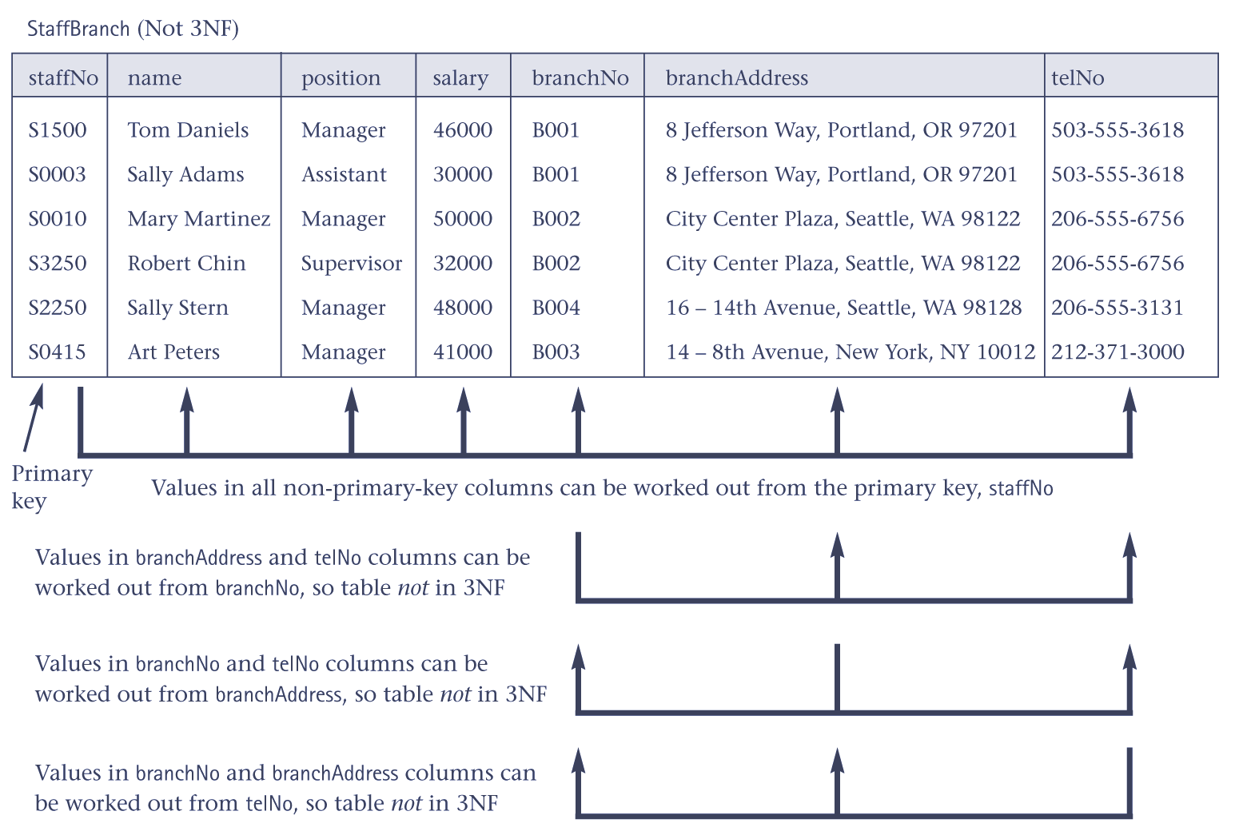
StaffBranch table is not in 3NF
© Pearson Education Limited, 2004

Slide 21
Third normal form (3NF)
The formal definition of 3NF is a table that is in 1NF and 2NF and in which no non-primary-key column is transitively dependent on the primary key.
© Pearson Education Limited, 2004

Slide 22
Third normal form (3NF)
For example, consider a table with A, B, and C. If B is functional dependent on A (A → B) and C is functional dependent on B (B → C), then C is transitively dependent on A via B (provided that A is not functionally dependent on B or C).
If a transitive dependency exists on the primary key, the table is not in 3NF.
© Pearson Education Limited, 2004

Slide 23
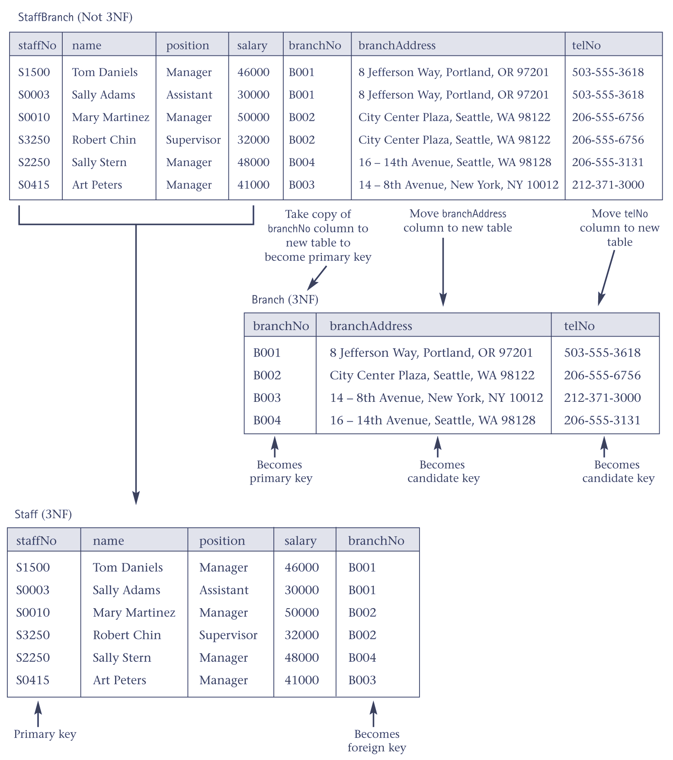
Converting the StaffBranch table to 3NF
© Pearson Education Limited, 2004

